Slide 1

CLEARING LINUX LOGS USING BASH SHELL
Project Supervisor: Dr. A.SIVASANGARI, M.E., Ph.D.,
Name of the Student: VIJAY.S
Register Number: 39120135

Slide 2
Presentation Outline:-
Course Certificate
Introduction
Objectives
System Architecture / Ideation Map
Project Requirements
Application Snapshots
Results and Discussions
Conclusion
References

Slide 3

Course Certificate

Slide 4
Introduction:-
Bash Shell
Bash is a Unix shell and command language written by Brian Fox for the GNU Project as a free software replacement for the Bourne shell. First released in 1989, it has been used as the default login shell for most Linux distributions. A version is also available for Windows 10 via the Windows Subsystem for Linux
A UNIX Shell is a program or a command line interpreter that interprets the user commands which are either entered by the user directly or which can be read from a file (i.e., Shall Script), and then pass them to the operating system for processing. It is important to note that Shall scripts are interpreted and not compiled, as the computer system interprets them and there is not any need to compile Shell Scripts in order of execution.

Slide 5
Objectives
Describe a simple command
Understand command-line syntax and run commands that include options and arguments
Explain how the shell interprets the command line
Redirect output of a command to a file, overwriting the file or appending to it
Redirect input for a command so it comes from a file
Connect commands using a pipeline
Run commands in the background
Use special characters as wildcards to generate filenames

Slide 6
Project Requirements:-
Hardware Requirements:
Processor : Processor intel i3 and above
Ram : 4 GB
Software Requirements:
Operating System : Linus
Virtual box (Virtualization).

Slide 7
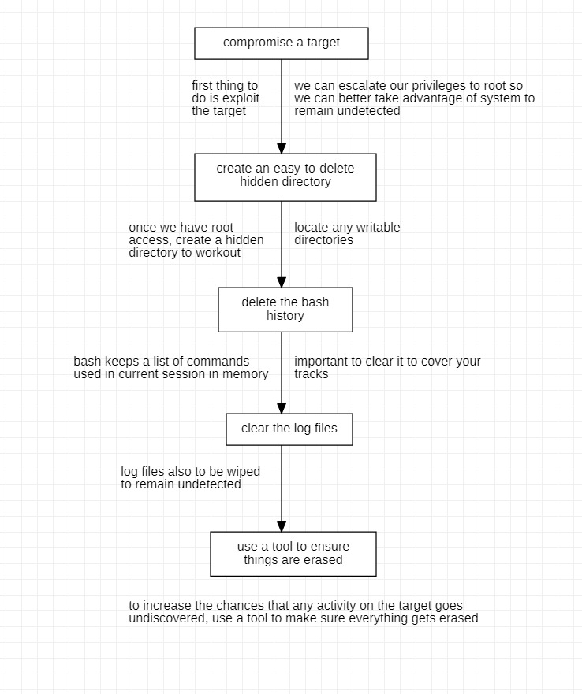
Ideation Map:-

Slide 8
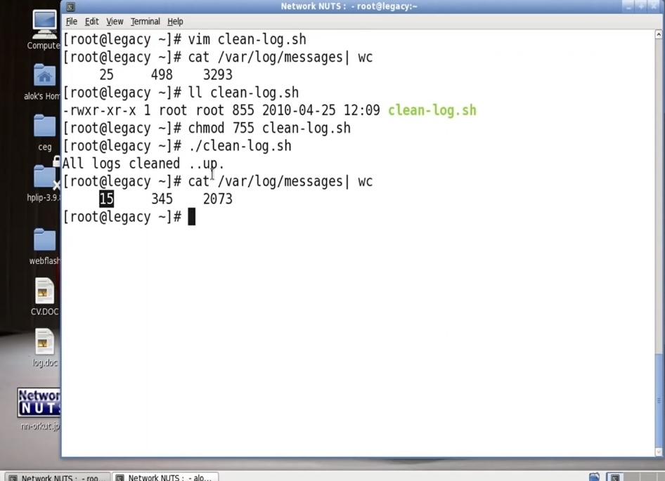
Application Screenshots:-

Slide 9
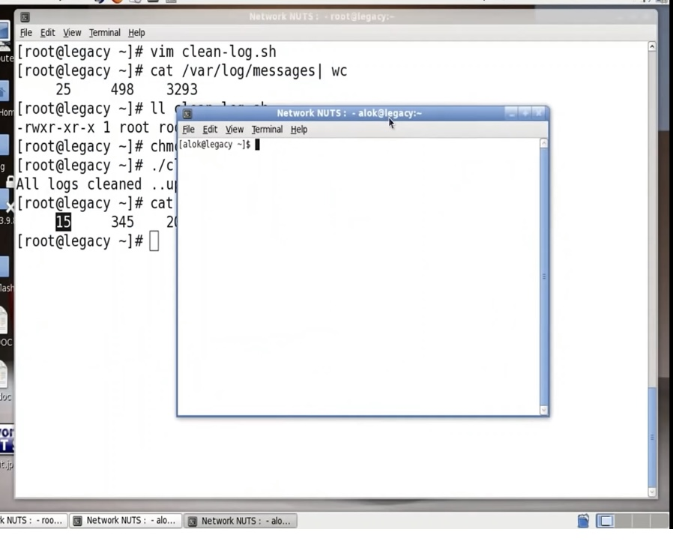
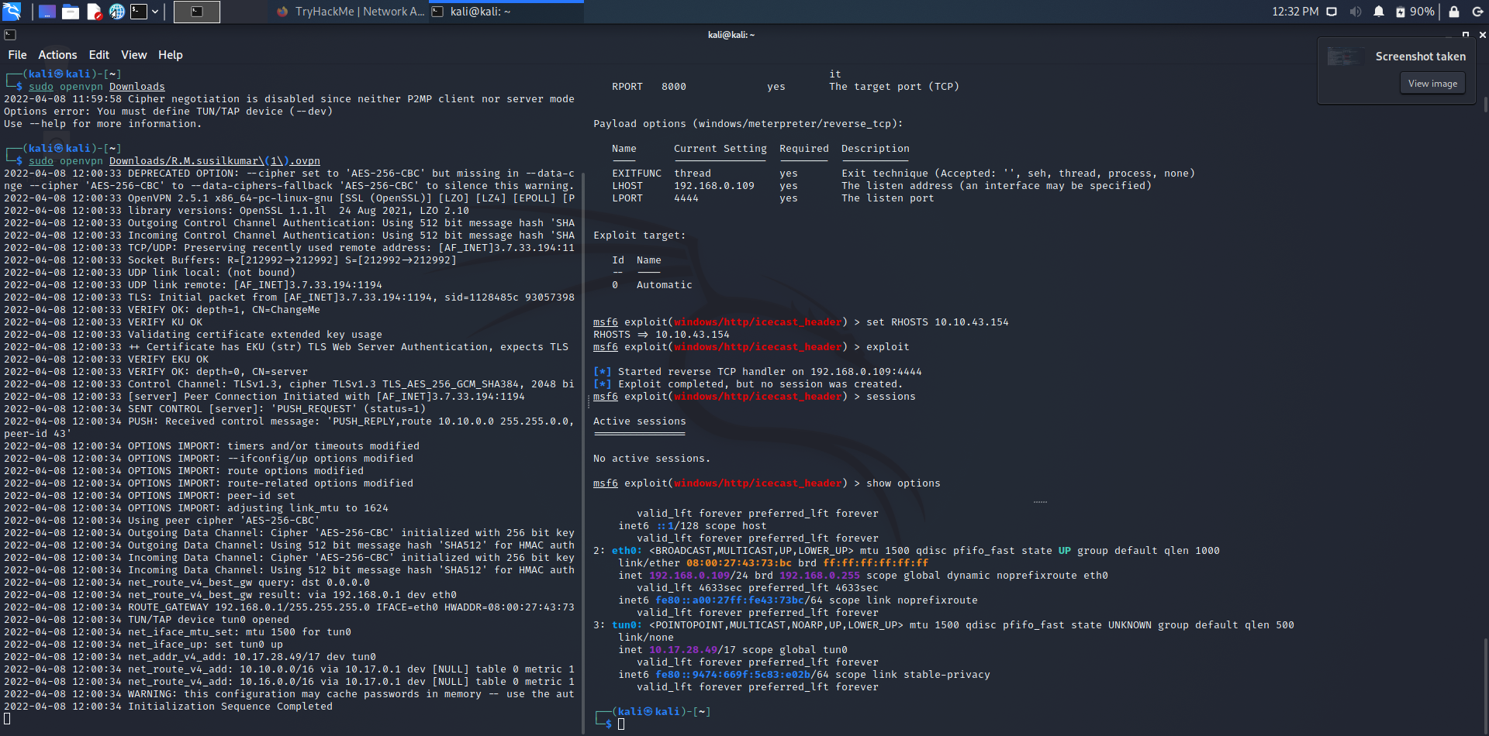

Slide 10
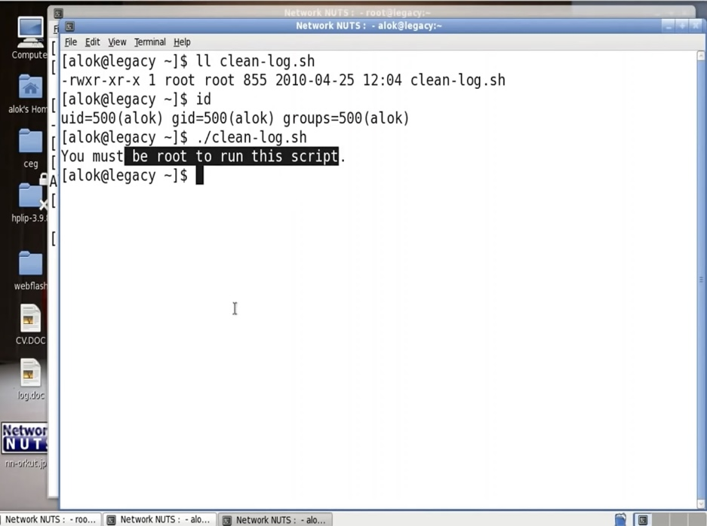
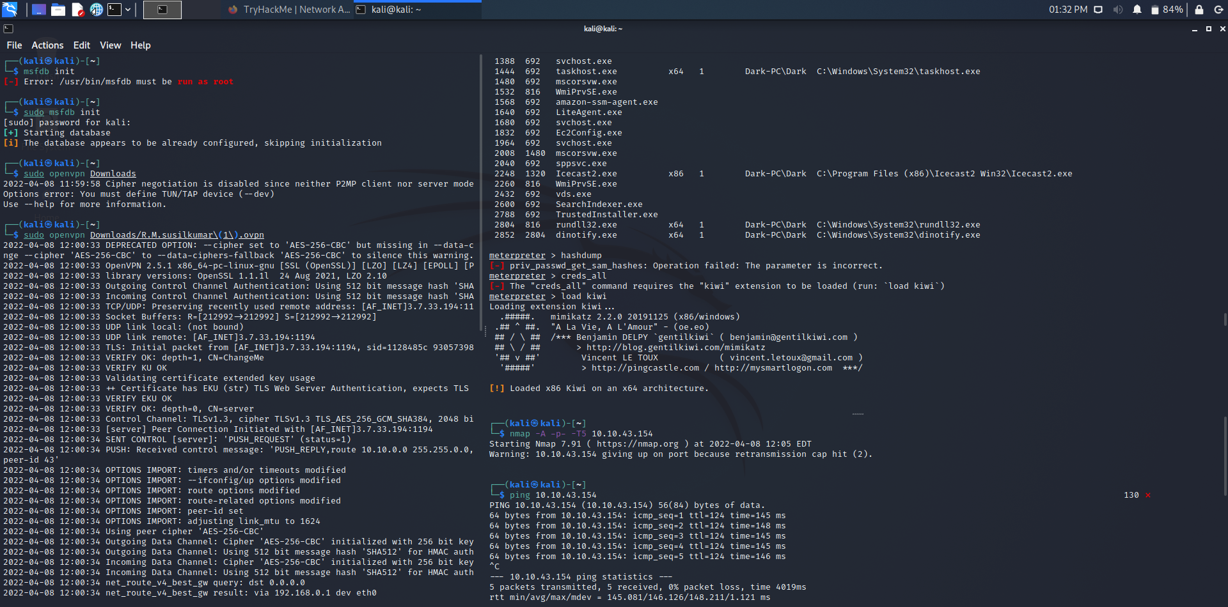

Slide 11
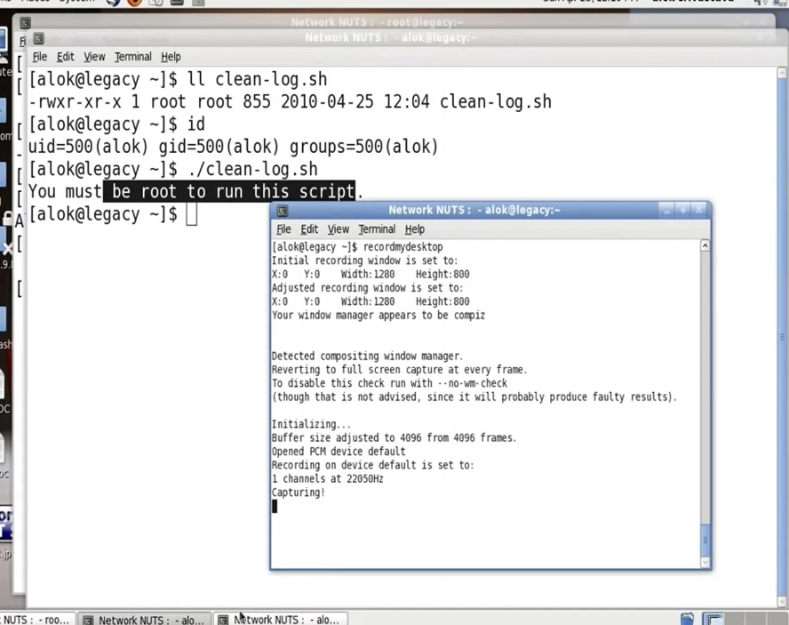
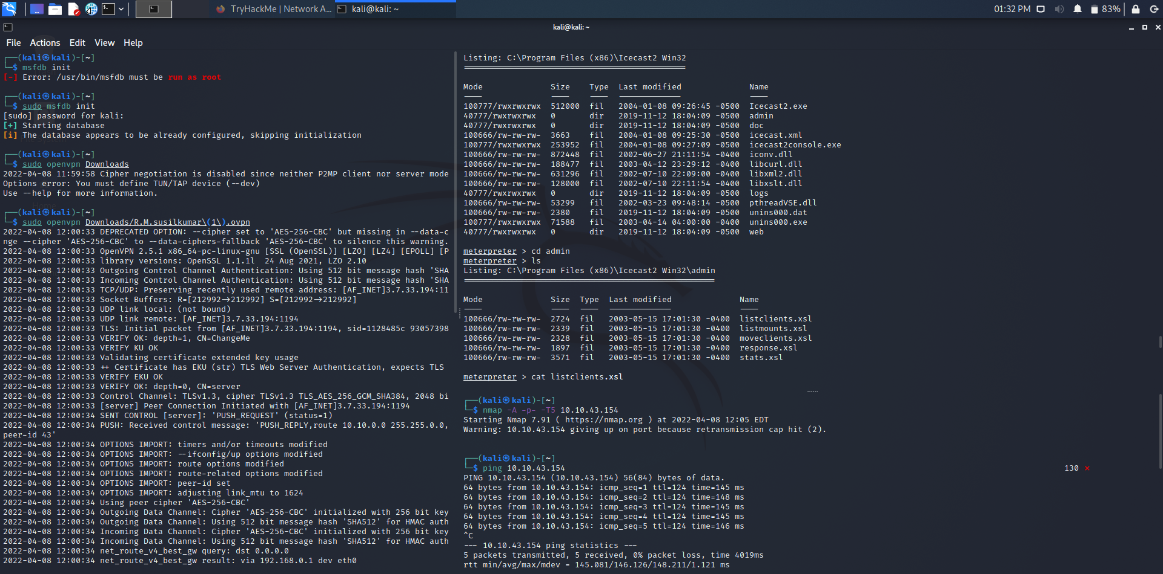

Slide 12
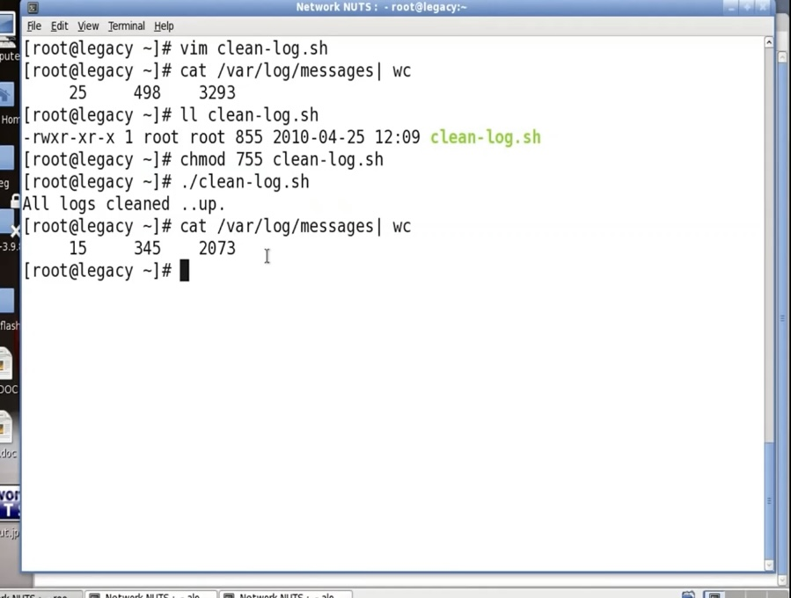
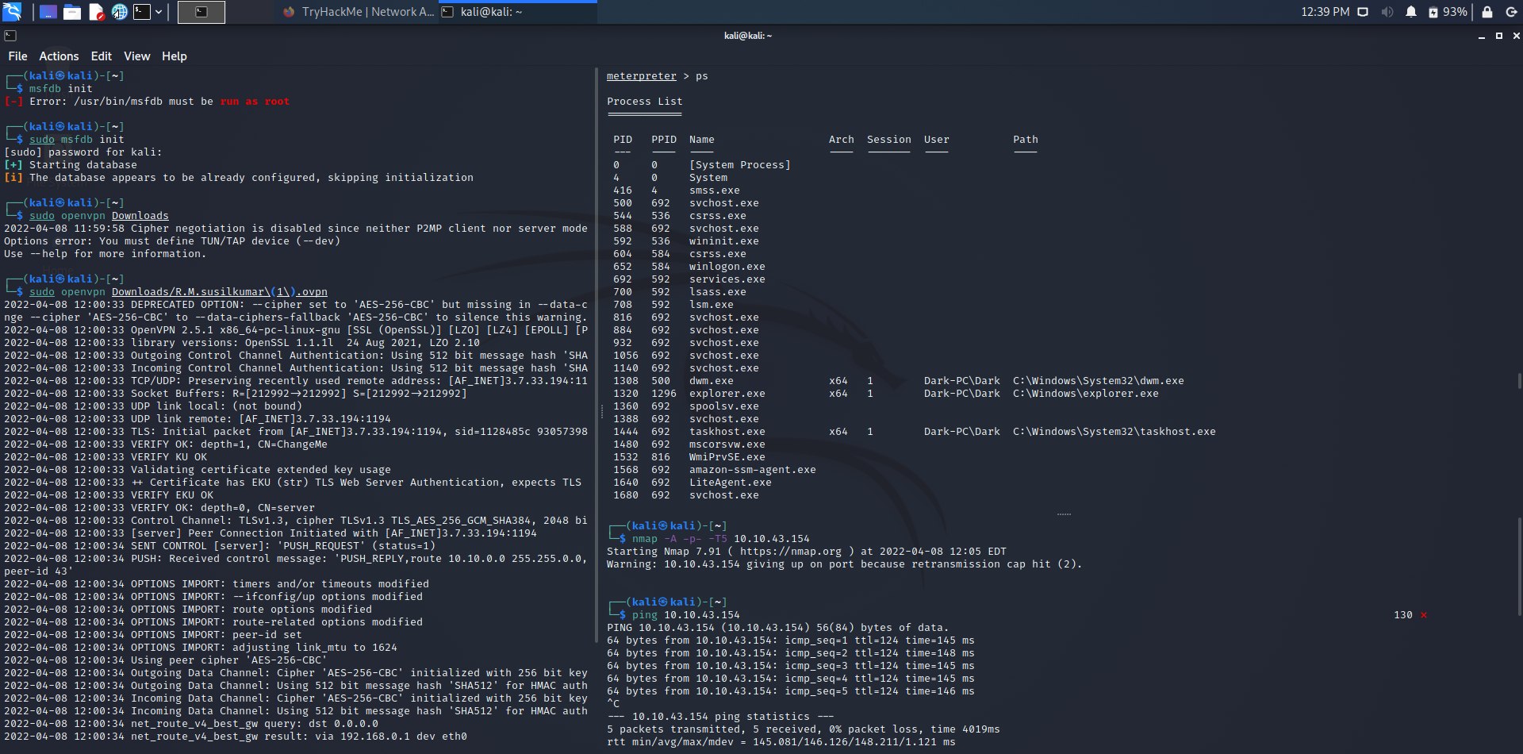

Slide 13
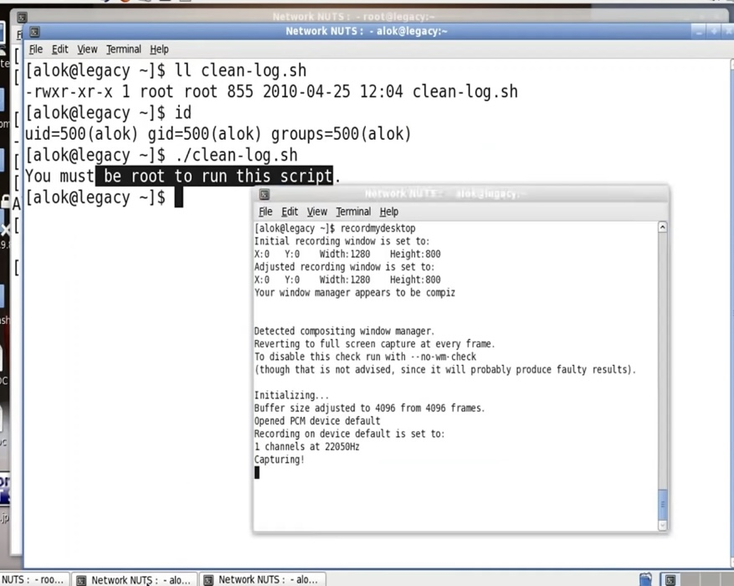
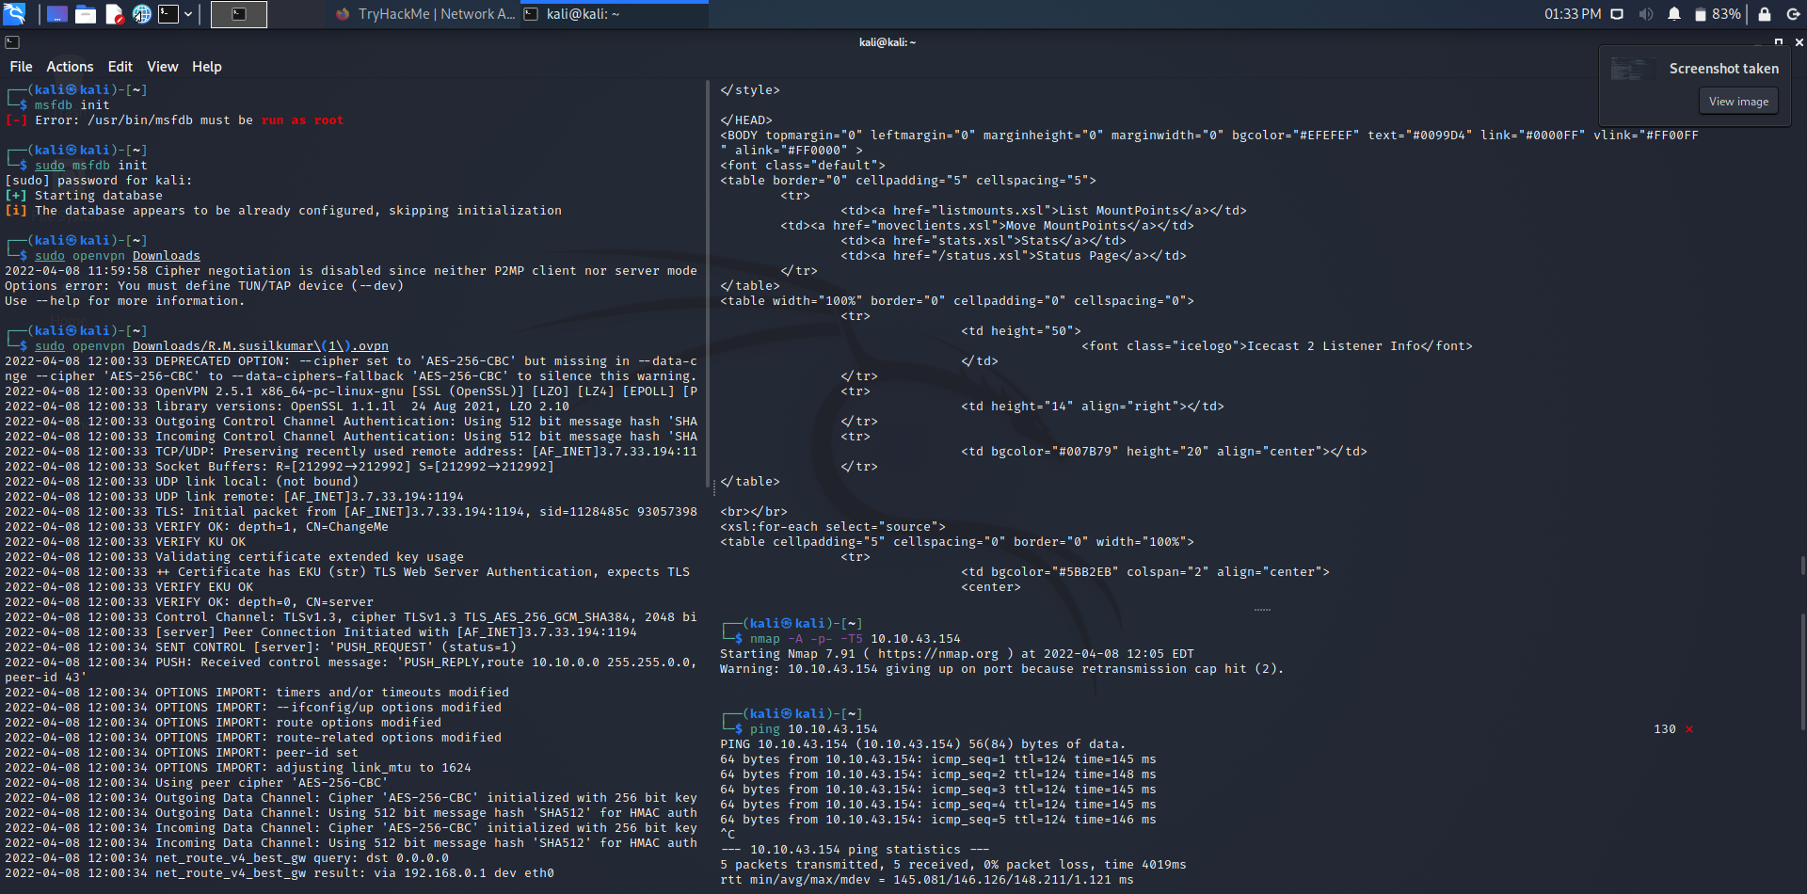

Slide 14
Conclusion:-
This project presents a recommendation system that uses Bashshell for Clearing Linux log with Linux(os). By using Bash script and the following commands used to delete and clear the old linux logs in linux os. This this project concludes we can delete logs using Bashshell.

Slide 15
Reference:-
EC Council. https://www.eccouncil.org/ethical-hacking/#:~:text=Ethical%20hacking%20is%20a%20process,and%20looking%20for%20weak%20points/
https://securiumsolutions.com/blog/hacking-windows-7-using-bashshell-backdoor-and-post-exploitation/
Wordpress. https://sathisharthars.wordpress.com/2014/05/21/hack-windows-7-with-bashshell-using-kali-linux/

